Slide 1
The Brightness Dependent Error Budget
Bijan Nemati
Original version: 10/22
Revision 1: 12/22

Slide 2
Overview
A first cut at the brightness dependent error budget is presented
To facilitate the discussion we go over the error budget fundamentals and associated aspects
The discussion is meant to follow the approach that Charley Noecker is using for the error budget

Slide 3
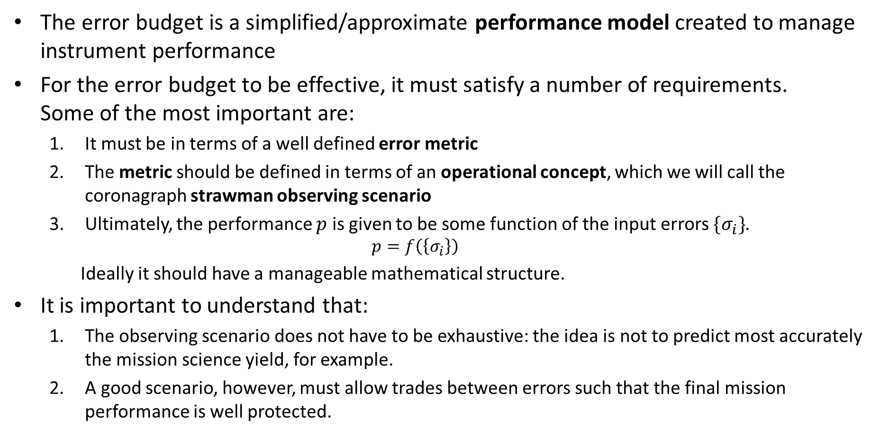
Error Budget Fundamentals
The error budget is a simplified/approximate performance model created to manage instrument performance
For the error budget to be effective, it must satisfy a number of requirements. Some of the most important are:
It must be in terms of a well defined error metric
The metric should be defined in terms of an operational concept, which we will call the coronagraph strawman observing scenario
Ultimately, the performance $p$ is given to be some function of the input errors $\{σ_{i}\}$.
$$p=f\left(\left\{σ_{i}\right\}\right)$$ Ideally it should have a manageable mathematical structure.
It is important to understand that:
The observing scenario does not have to be exhaustive: the idea is not to predict most accurately the mission science yield, for example.
A good scenario, however, must allow trades between errors such that the final mission performance is well protected.

Slide 4
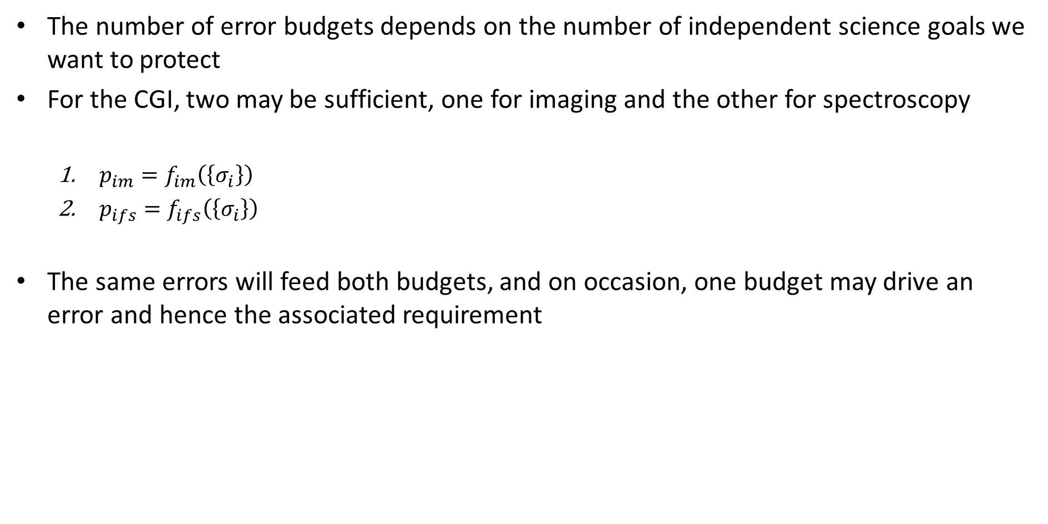
How Many Error Budgets?
The number of error budgets depends on the number of independent science goals we want to protect
For the CGI, two may be sufficient, one for imaging and the other for spectroscopy
$p_{im}=f_{im}\left(\left\{σ_{i}\right\}\right)$
$p_{ifs}=f_{ifs}\left(\left\{σ_{i}\right\}\right)$
The same errors will feed both budgets, and on occasion, one budget may drive an error and hence the associated requirement

Slide 5
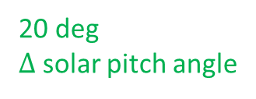
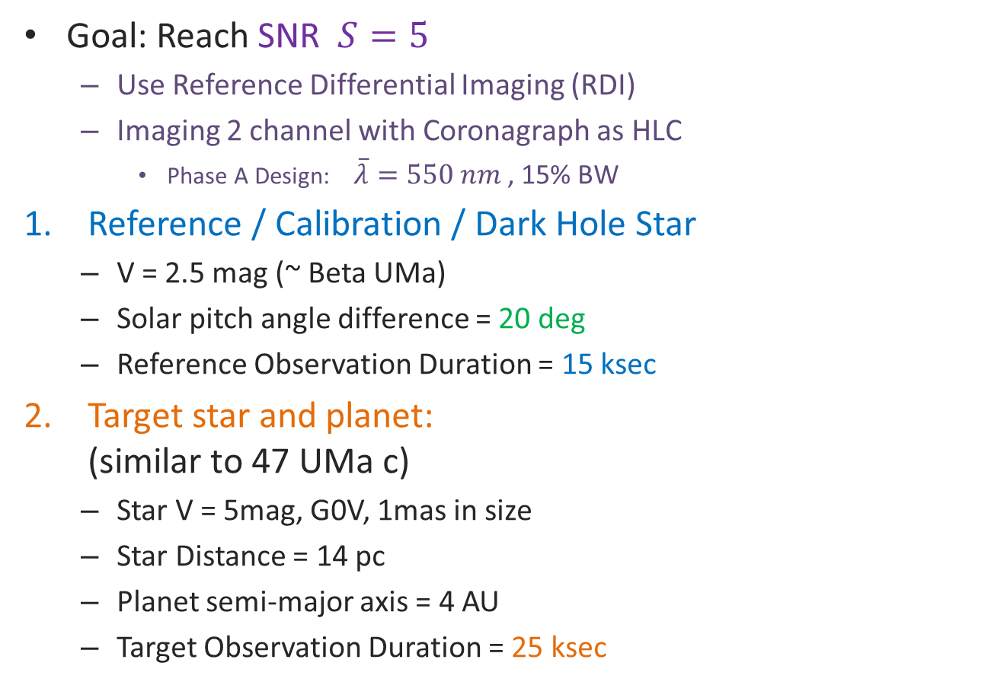


Proposed Strawman Observing Scenario: Imaging
Goal: Reach SNR $S=5$
Use Reference Differential Imaging (RDI)
Imaging 2 channel with Coronagraph as HLC
Phase A Design: $\overline{λ}=550 nm$ , 15% BW
Reference / Calibration / Dark Hole Star
V = 2.5 mag (~ Beta UMa)
Solar pitch angle difference = 20 deg
Reference Observation Duration = 15 ksec
Target star and planet: (similar to 47 UMa c)
Star V = 5mag, G0V, 1mas in size
Star Distance = 14 pc
Planet semi-major axis = 4 AU
Target Observation Duration = 25 ksec
1
20 deg $Δ$ solar pitch angle
Bright star for acquisition of DH
$$V=2.5mag$$
Science star
2
15 ksec
$$V=5 mag$$
25 ksec
The IFS scenario is similar, but with different durations and coronagraph settings. The target observation duration can be set to 330 ksec for IFS1

Slide 6

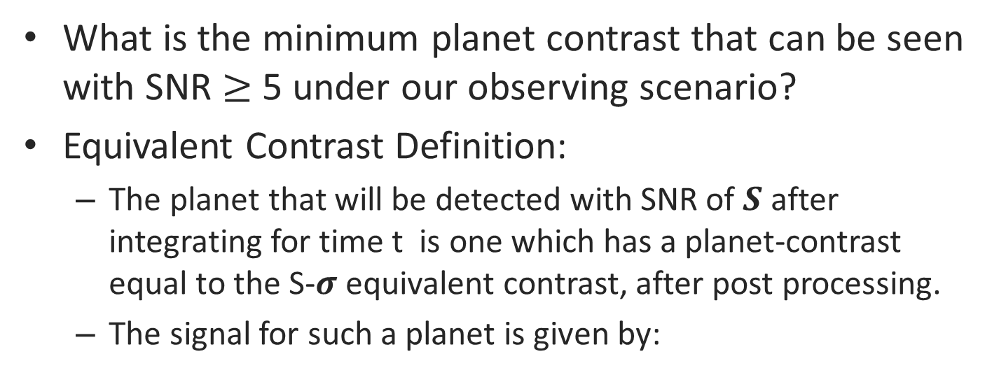
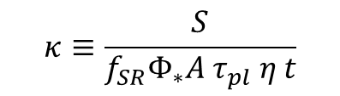

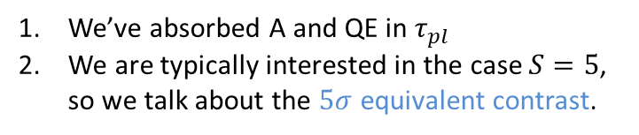
The Metric: Noise Equivalent Contrast
What is the minimum planet contrast that can be seen with SNR $≥$ 5 under our observing scenario?
Equivalent Contrast Definition:
The planet that will be detected with SNR of 𝑺 after integrating for time t is one which has a planet-contrast equal to the S-𝝈 equivalent contrast, after post processing.
The signal for such a planet is given by:
R
How dim a planet can be seen with SNR=5?
T
Planet signal in the core region
after t seconds
signal
fraction
area
QE
We’ve absorbed A and QE in $τ_{pl}$
We are typically interested in the case $S=5$, so we talk about the $5σ$ equivalent contrast.
$${f_{SR}⋅Φ}_{∗}C_{eq}{A τ}_{pl} η t=S{⋅σ}_{tot}$$
flux
thruput
time
$$C_{eq}=κ{⋅σ}_{tot}$$
Our definition of equivalent contrast
$$κ≡\frac{S}{{f_{SR}Φ}_{∗}{A τ}_{pl} η t}$$
This conversion factor is set by the scenario parameters

Slide 7
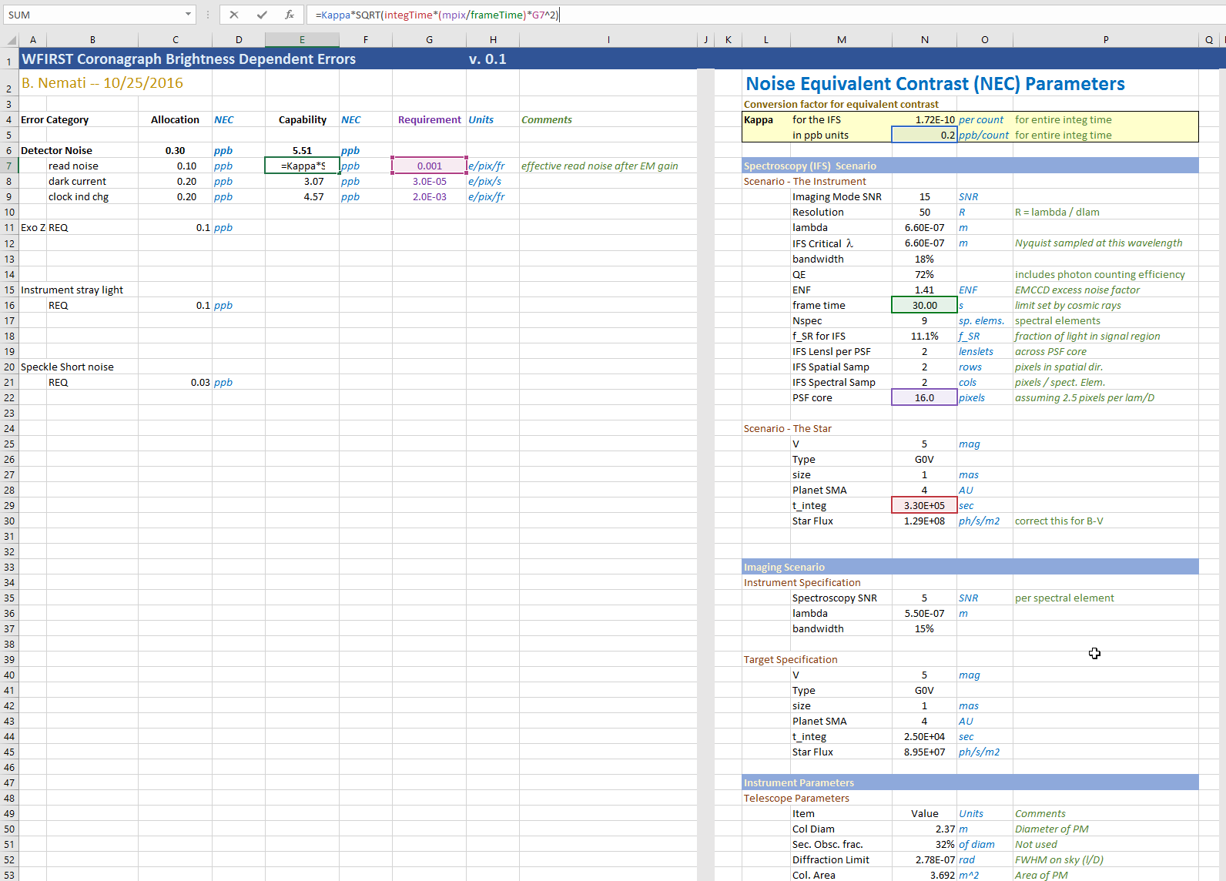
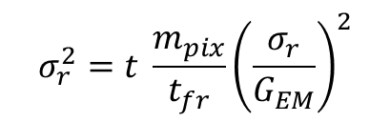

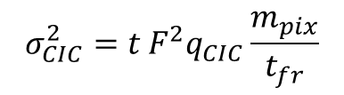
BDE Error Budget version 0,1
$$σ_{r}^{2}=t \frac{m_{pix}}{t_{fr}}{\left(\frac{σ_{r}}{G_{EM}}\right)}^{2}$$
$$σ_{d}^{2}=t F^{2}i_{d}m_{pix}$$
$$σ_{CIC}^{2}={t F}^{2}q_{CIC}\frac{m_{pix}}{t_{fr}}$$

Slide 8
backup

Slide 9








Equivalent Contrast
It might be helpful to factor the equations a little differently to see how the SNR improves with time.
Consider the noise variance, which can be broken up into temporal and spatial terms:
$$σ_{tot}^{2}=σ_{t}^{2}+σ_{s}^{2}$$
Using the earlier slide’s definitions:
$$\frac{σ_{t}^{2}}{t}=r_{n}={f_{SR} F}^{2}\left[{Φ_{∗} C_{pl} τ_{pl}+Φ}_{∗}C_{CG}I_{pk}m_{pix}τ_{sp}+\left(\frac{dΦ_{Z}}{dΩ} ΔΩ_{PSF}\right)τ_{Z}\right] A_{PM} η+F^{2}\left[i_{d}m_{pix}+q_{CIC}\frac{m_{pix}}{t_{fr}}\right]+\frac{m_{pix}}{t_{fr}}{\left(\frac{σ_{r}}{G_{EM}}\right)}^{2}$$
$$σ_{s}^{2}=f_{pp}⋅f_{SR}⋅Φ_{∗}C_{CG}I_{pk}m_{pix}τ_{sp}{ A}_{PM} η t=f_{pp} r_{sp} t$$
Equivalent Contrast Definition:
The planet that will be detected with SNR of $S$after integrating for time t is one which has a planet-contrast
equal to the S-$σ$ equivalent contrast. The signal for such a planet is given by:
$$Φ_{∗}C_{eq}τ_{pl} t=S{⋅σ}_{tot}$$
We are typically interested in the case $S=5$, so we talk about the $5σ$ equivalent contrast.
Here, absorbed A and $η$ into $τ_{pl}$
$σ_{t}$ dominated; not much benefit
from post-processing
For imaging, $f_{SR}=1$, so for simplicity we drop this factor, and we have:
$$C_{eq}$$
$$C_{eq}=\frac{S{ σ}_{tot }}{{Φ_{∗}τ}_{pl} t}=S\sqrt{\frac{r_{n}t+f_{pp}^{2}r_{sp}^{2}t^{2}}{{Φ_{∗}^{2}τ_{pl}^{2}t^{2}}_{ }}}=S\sqrt{\frac{r_{n}}{{Φ_{∗}τ}_{pl} t}+f_{pp}^{2}\frac{r_{sp}^{2}}{Φ_{∗}^{2}τ_{pl}^{2}}}$$
t
Due to the statistical nature of the data that goes into achieving $f_{pp}$, it is implicitly a function of time, so we really can write it as $f_{pp}\left(t\right).$For short integration times, we can expect $f_{pp}$ to be decreasing (random errors) while for long times drifts will cause it to flatten or even increase.
For very short times the first term dominates and there is no benefit from post-processing
At large times, the first term under the radical drops out, so that we arrive at:
$$C_{eq}\underset{→}{\text{t}→∞}S f_{pp}\left(t\right)\frac{r_{sp}}{Φ_{∗}τ_{pl}}$$

